Slide 1
Fridge Online Param ID

Slide 2
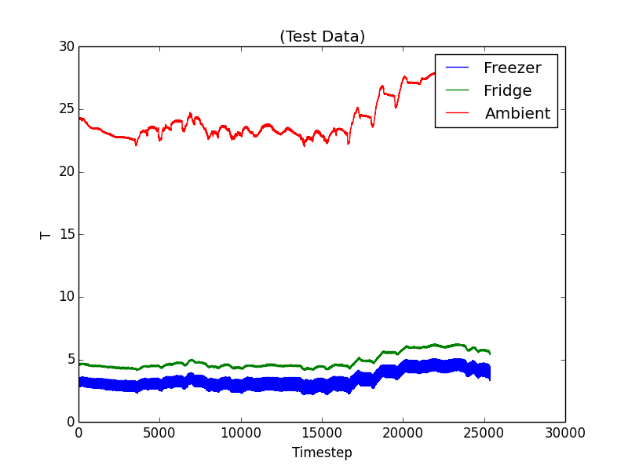
The Data

Slide 3
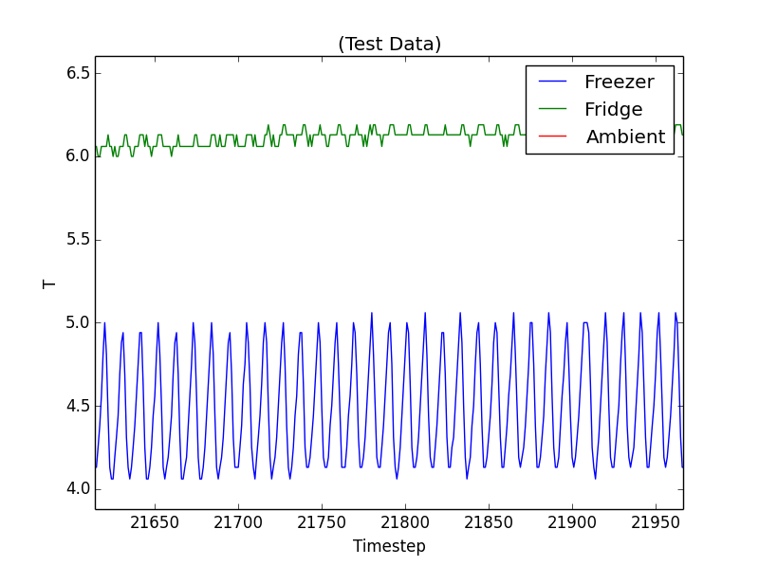
The Data

Slide 4
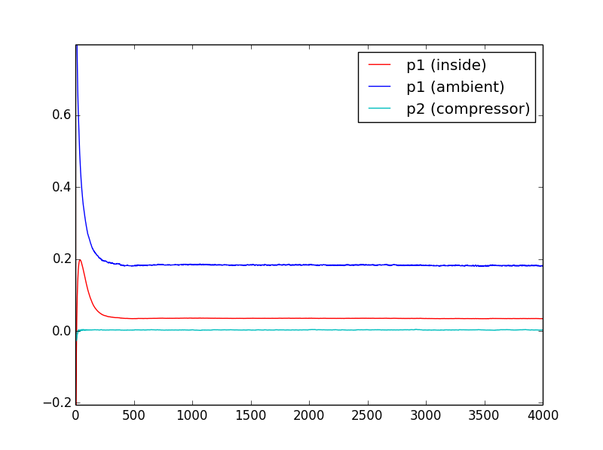

Model 1: Estimate Fridge T
$$T\left(k+1\right)=p_{1}T\left(k\right)+p_{2}T_{AMB}\left(k\right)+p_{3}U_{c}(k)$$
T_AMB
T
U_c

Slide 5
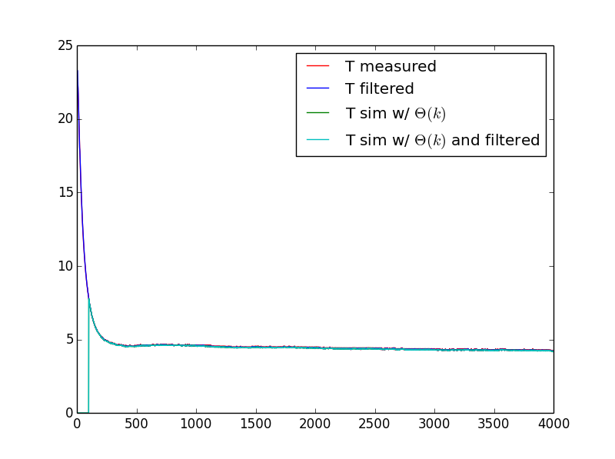
RMSE: 0.041 C

Slide 6
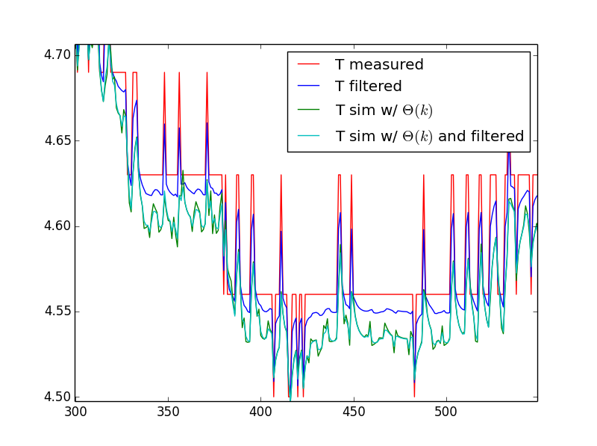
RMSE: 0.041 C

Slide 7
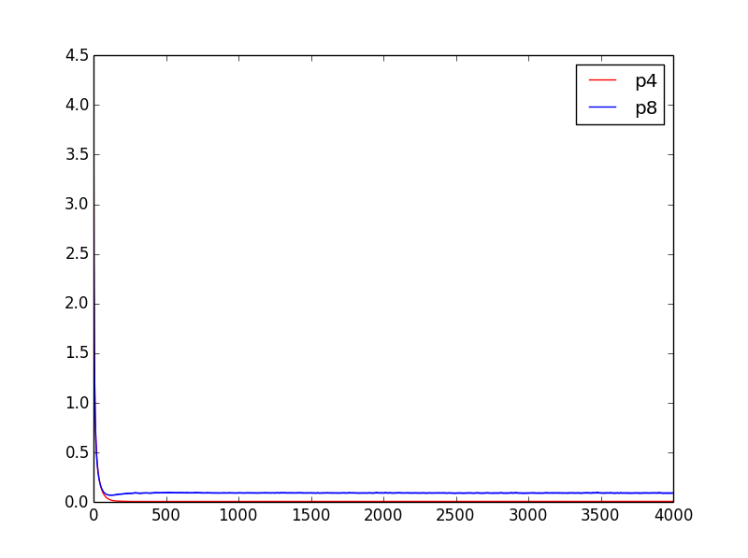

Model 2: Fridge and Freezer T
$$T_{FRZ}\left(k+1\right)=p_{1}T_{FRZ}\left(k\right)+p_{2}T\left(k\right)+p_{3}U_{c}\left(k\right)+p_{4}$$
$$T\left(k+1\right)=p_{5}T_{FRZ}\left(k\right)+p_{6}T\left(k\right)+p_{7}T_{AMB}\left(k\right)+p_{8}$$
T_AMB
T
T_FRZ
U_c

Slide 8
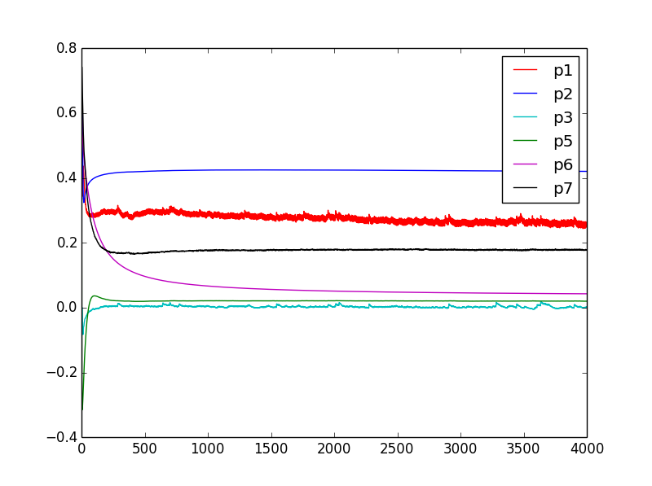

Slide 9
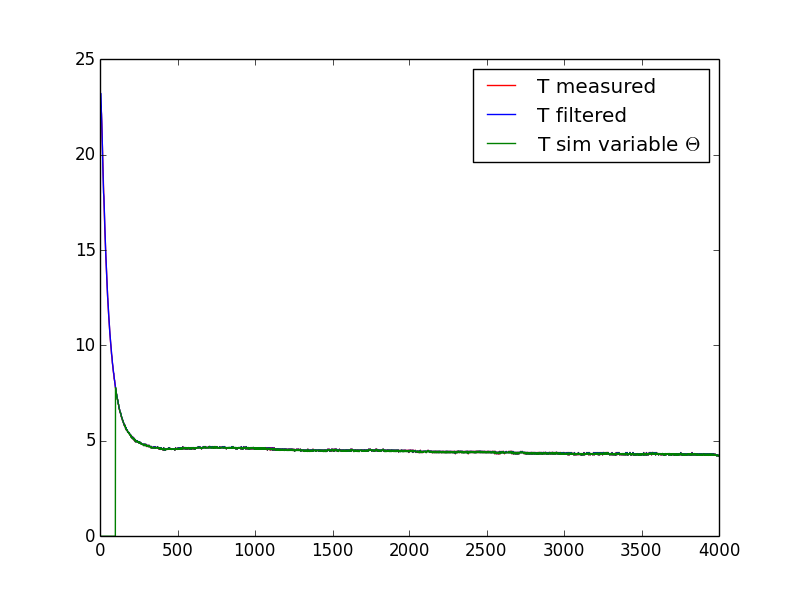
RMSE: 0.029 C

Slide 10
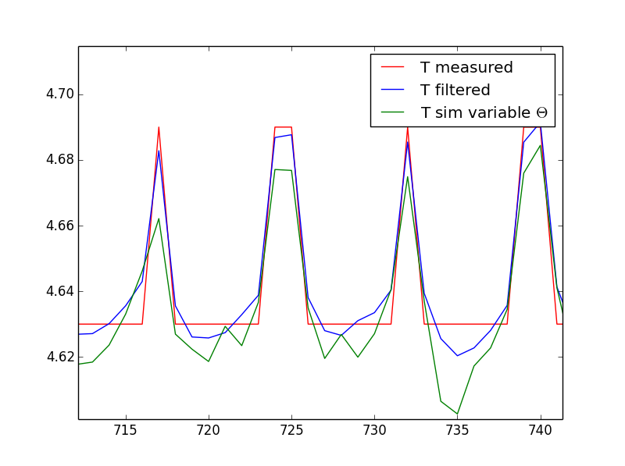
RMSE: 0.029 C

